Slide 1

Looking After our Spiritual & Mental
Health (post Pandemic)
WELCOME
Essex Mind & Spirit
St John’s Colchester
23rd June 2022
Paul McNamara
NELFT Chaplain

Slide 2
The role of Hospital Chaplaincy in mental health?
Providing spiritual, religious and pastoral care to patients, service users, families,
carers and staff……. Also reaching out to support mental health community service users……
The nature of “holistic care”
Life in abundance and life to all……..

Slide 3
What is good mental health?
“the emotional and spiritual resilience which allows us to enjoy life and survive pain, disappointment and sadness. It is a positive sense of well-being and an underlying belief in our own, and others’, dignity and worth.”
- Health Education Authority

Slide 4
What is poor mental health?
“a health condition involving a significant change to a person’s thinking, emotions and behaviour. These changes will go beyond a ‘minor annoyance’ and will most likely affect that person’s ability to engage in everyday life – their work, relationships and faith involvement.”

Slide 5
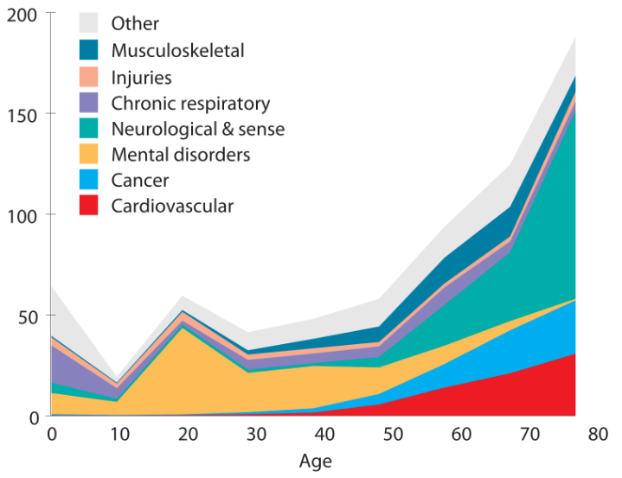
Health conditions and age
Problems with mental health can occur at any time – but there is a spike in early adulthood

Slide 6
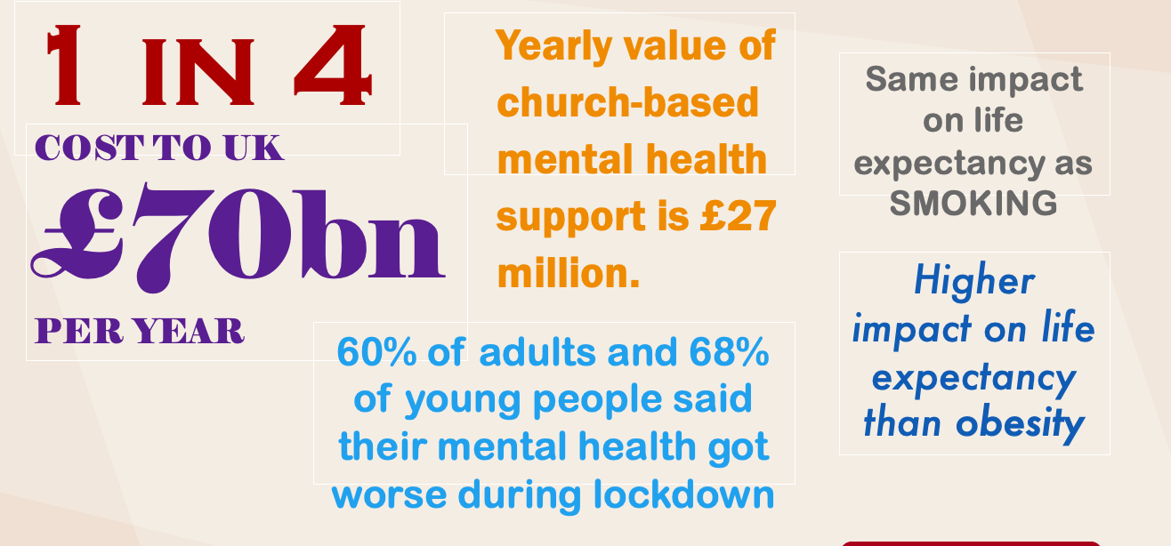
A few statistics….

Slide 7
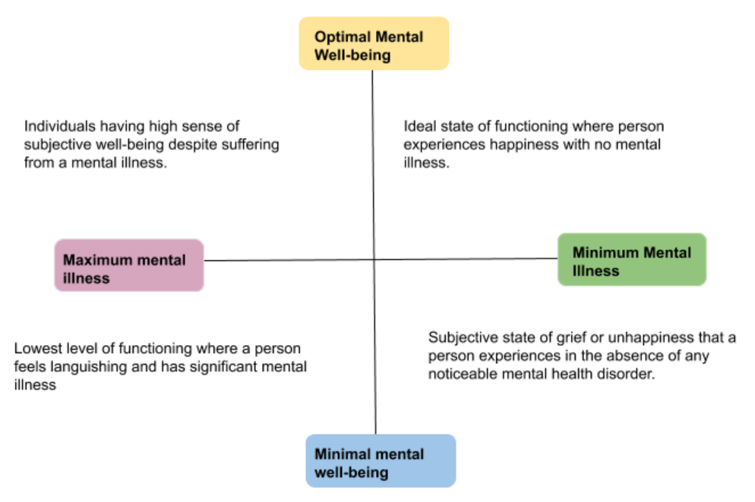
It is helpful to speak of good and poor mental health in the context of wellbeing as shown by the diagram (right)

Slide 8
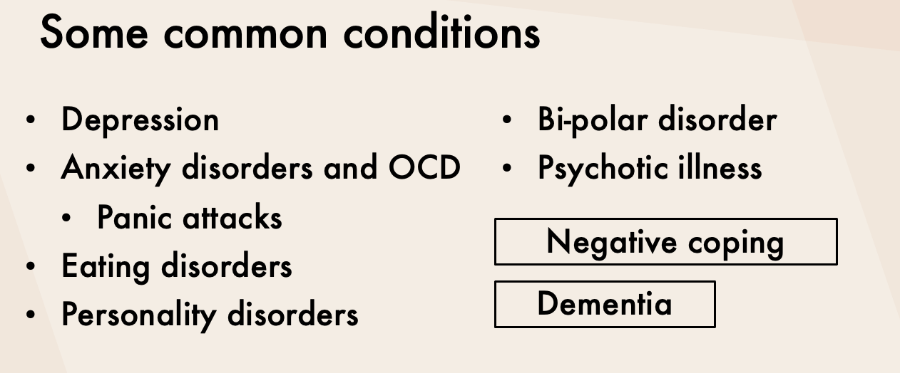

Slide 9
The Impact of the Pandemic
Anxiety, isolation, depression, an escalation of present conditions, longer term suffering, long covid, reduced development, lack of community, lack of work, lack of religious and spiritual support, health inequality etc.

Slide 10
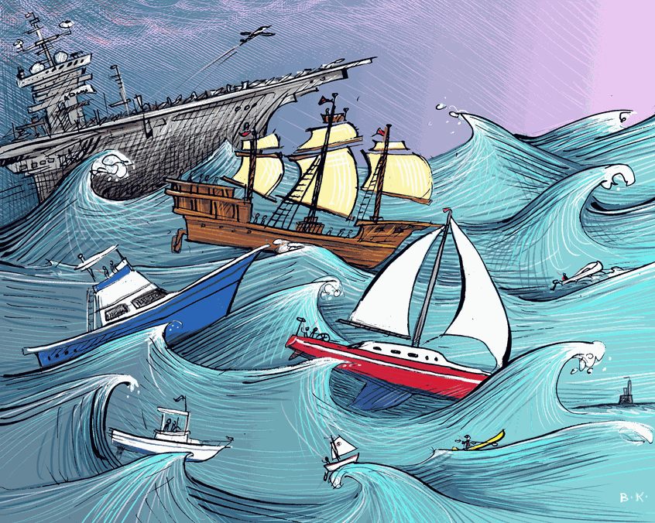
The Impact of the Pandemic
We are all in the same storm, but not in the same boat!

Slide 11
But there’s more………
In the last 6 months……..
The War in Ukraine
Political Scandal/Division
Utility Prices
Inflation/Food Banks
Ongoing political turmoil
e.g. NI Protocol EEC
Climate Change
Increased uncertainty

Slide 12
Grief & Mourning
How do we define grief?
What are our losses?
Family, Friends, Hope, Identity, Work, Income, Routine, Health, Faith, Ritual/Practice, Social Interaction, Nourishment for Mind Body & Spirit

Slide 13
Grief & Mourning
How do we define Mourning?
Working through the internal emotions and feelings through expression of grief…… some examples
NHS de briefs, local gatherings to share stories

Slide 14
What can we do for ourselves?
Oxygen masks: put your own on first before helping others…………..
Wellbeing Checklist:
Hydration
Food
Sleep
Exercise
Creativity
Socialisation
Spiritual

Slide 15
What can we do for others?
Our families, friends, community etc.
Noticing, listening, making connection through empathy, not fixing, acceptance of how people are feeling, valuing one another through shared experiences and building memories helping people to find meaning
E.g. Local What’sapp Group

Slide 16
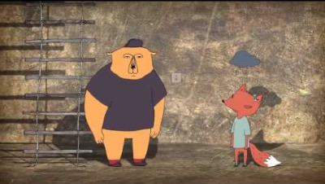
Empathy v. Sympathy

Slide 17
Where To Get Help…..
999 A & E
GP
Mental Health Direct 0300 555 1000
Samaritans
Mind
mind.org.uk
Open Adult Counselling Service www.oacs.org.uk
07963 279272 / 07722 958017
Shout Crisis Text Line text “SHOUT” to 85258
Under 19’s Childline: 0800 1111

Slide 18
Questions, comments, and clarification
Over to you
If you have any questions relating to this presentation please contact Paul McNamara on 07713 709428

